Slide 1
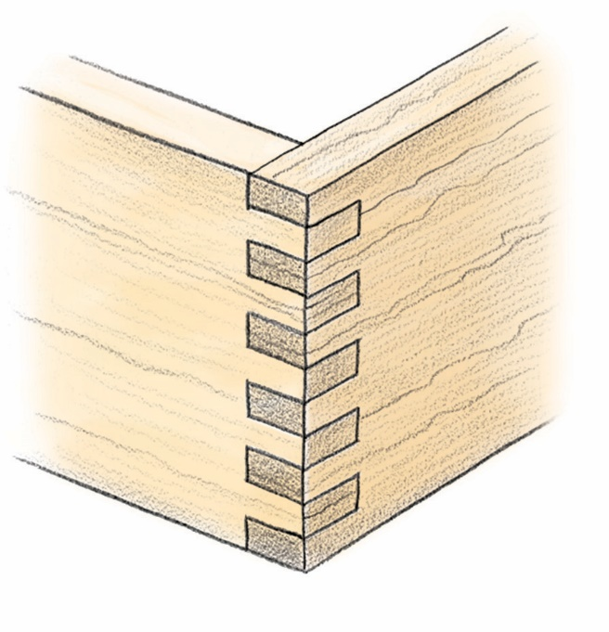
Box Joint Gadget Ver. 1.1
Jim Anderson
Houston Texas
March 2015

Slide 2
The Disclaimer
This gadgets is entirely optional add-in to Vectric's core products. It is provided 'as-is', without any express or implied warranty, and you make use of it entirely at your own risk. In no event will the author(s) or Vectric Ltd. be held liable for any damages arising from it’s use.
Permission is granted to anyone to use this software for any purpose, including commercial applications, and to alter it and redistribute it freely, subject to the following restrictions:
1. The origin of this software must not be misrepresented; you must not claim that you wrote the original software. If you use this software in a product, an acknowledgement in the product documentation would be appreciated but is not required.
2. Altered source versions must be plainly marked as such, and must not be misrepresented as being the original software.
3. The notice may not be removed or altered from any source distribution.
The Create Box joint Vectors and Tool paths gadget was formed by Jim Anderson of Houston, Texas. (Mar 2015)
The Create Box joint Vectors and Tool paths gadget program is very heavily based on code from Vectric's core software SDK, Brian Moran code and many other great software developers.

Slide 3
Some program details
The material is held in a vertical position on the mill
The material Z must be set to top of material
The Z value is normally the length of material
The XY Datum position, must be in any corner, but not in the center of material
The milling action is performed on the end of the boards
The user can adjust the number of fingers/gaps by changing the Total No. Fingers
No special Bit required (end mill)
The program creates both the right and left hand tool paths
The program has error trapping, to include bit diameter compared to finger gap and many more

Slide 4
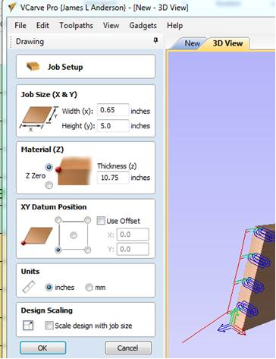
Material & Job Setup
Set the Material to represent the part to be milled in the vertical position
Material (Z) to set to
Top
Always select a corner of the Material for XY Datum Position
Material Thickness is the length of part

Slide 5
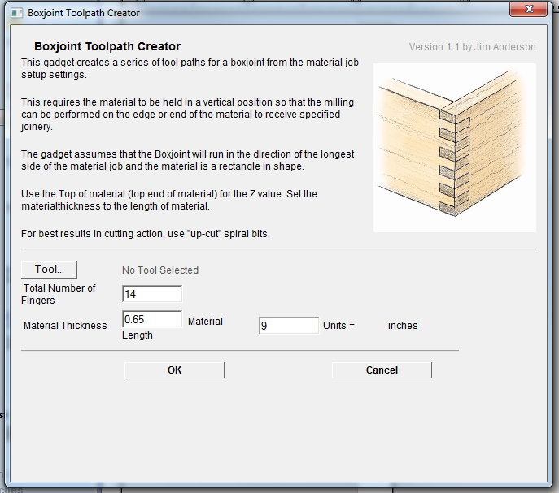
User dialogue
Select Tool to open dialog box to select cutting tool
Adjust the number of total joints per corner. Even number will put the same count on both parts. Odd number will put stager count per part
Read only values. To change Material size use Job Setup

Slide 6
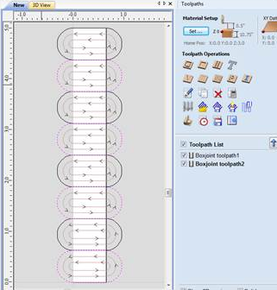
Closed vectors and Tool paths
The Gadget will build vectors and tool paths any orientation. In the “Y” axis Vertically

Slide 7
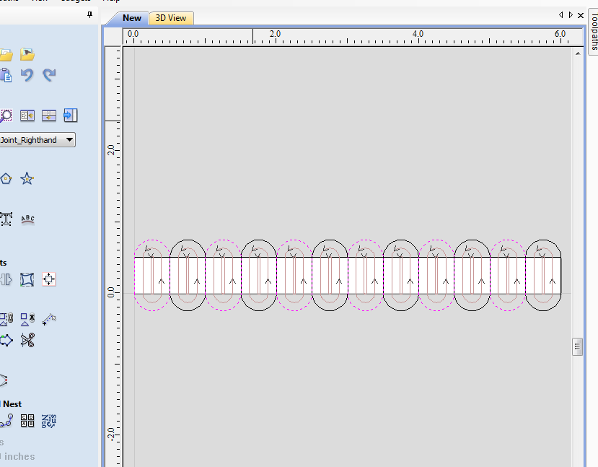
Closed vectors and Tool paths
The Gadget will build vectors and tool paths any orientation. In the “X” axis Horizontally

Slide 8
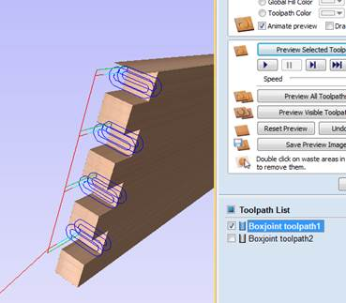
Tool path rendering
Recommend separating the tool paths into two (2) individual G-Code output files.
Render Each Joint Separately

Slide 9


